Slide 1
Analysis for Top Soccer Player’s Wage
615 Final project presentation for Samuel Luo

Slide 2
Introduction
In the current world, many famous soccer players are fully appreciated by soccer
clubs and fans. Since they are in top-level clubs, they are paid an attractive salary
that many people dream of it. As a soccer fan and also a statistics student, there are several
questions come to my eyes:
1. If we take their nationalities into account, which
countries’ players would make more money compared to other?
2. Although we know that a player’s wage highly depends on their abilities and which club does he
join, for the top players who their abilities are nearly the same, is there a relationship between their
nationalities and their wages?
3.What about the impact of their height and weight on the wage?
This report is going to reveal to what extent and how does height, weight and
nationality affect top soccer player’s wages and how is the accuracy of their wages in this data?

Slide 3
Data Source and Import
The data source I used is originally scraped from sofifa.com, which is now under the folder ‘Fifa18 more complete player dataset’ in Kaggle.com.
This file includes nearly all soccer players data in the current world, since the subjects I am focusing on are the top soccer players, I removed the players whose official evaluations are under 70/100.

Slide 4
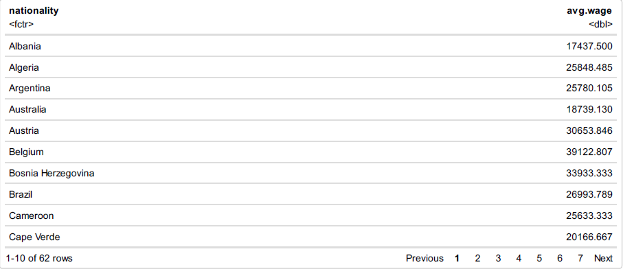
Observation
Before fitting a model for find out the answers, I am willing to have a basic understanding of the average weight, height and average wage for top players from different countries.

Slide 5
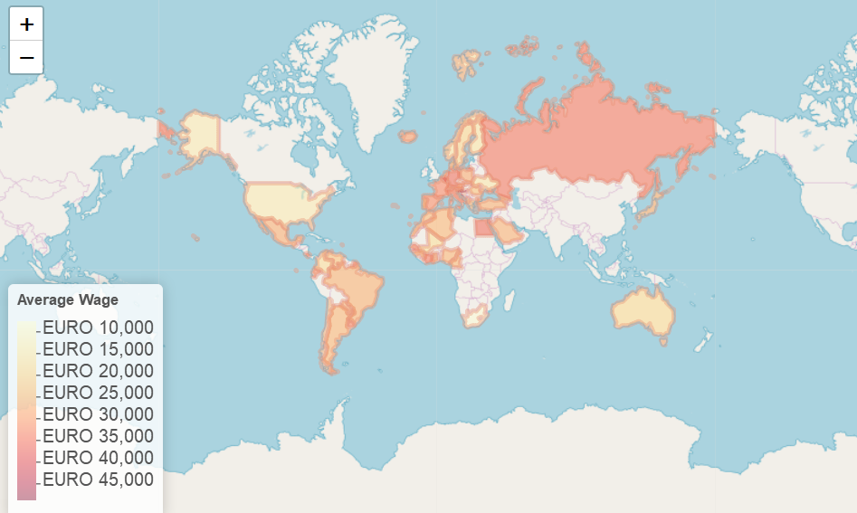
After that, I calculated the average weight, height and average wage of top soccer players from different countries. And then I would put these results into leaflet which can help the audience clearly see the average weight, height and wage in different countries.
I thought that the taller a player is, the higher wage he will get. But from the maps, it is clearly that at least for some countries, the players’ average height are taller, their wage are not higher.

Slide 6
Average Wage Map

Slide 7
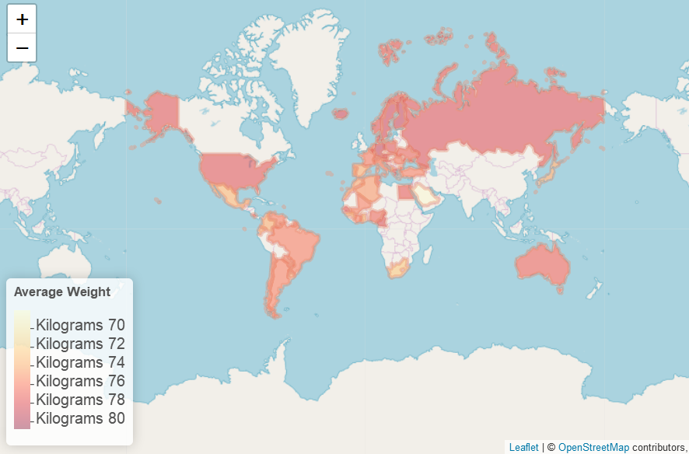
Average Height Map

Slide 8
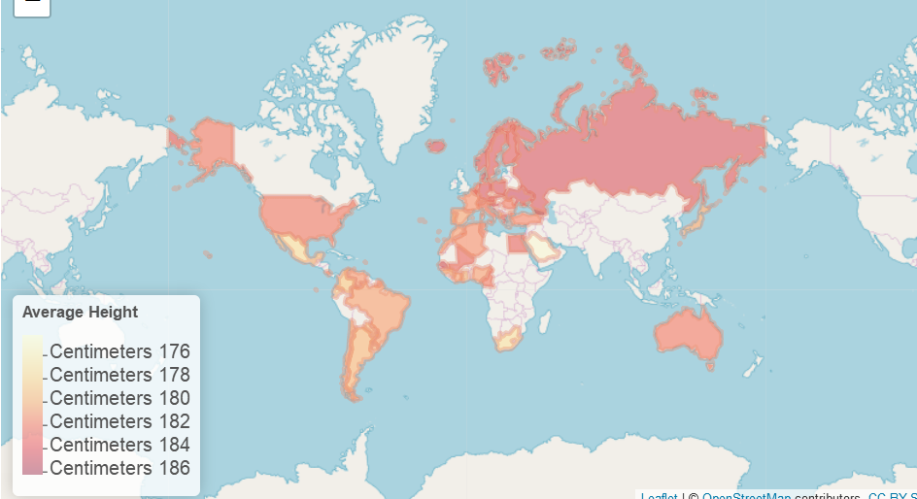
Average Weight Map

Slide 9
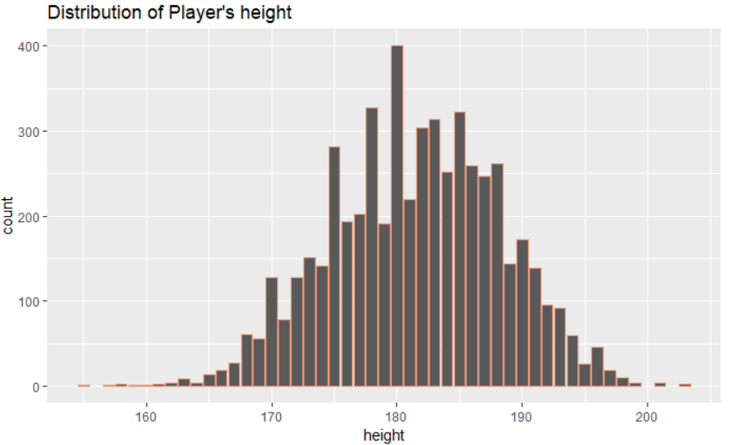
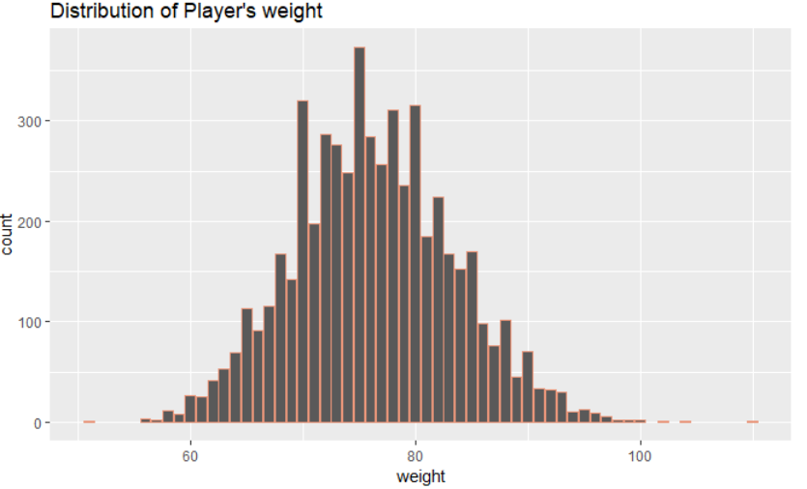
EDA

Slide 10
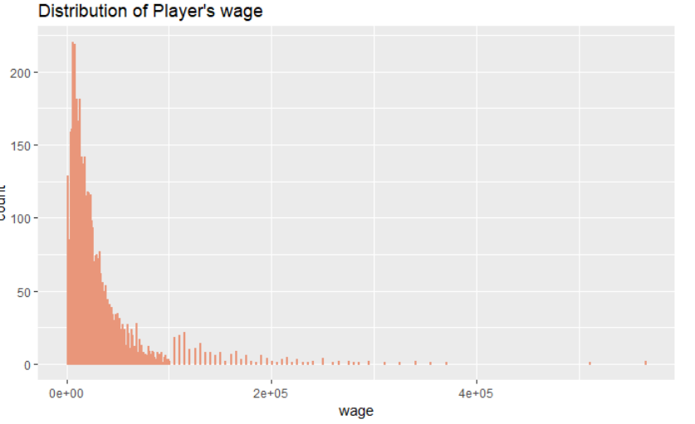
From the distributions of players' weight and height, which seems like normal distributions, we can see most of the players are around 180 cm height and 75 kg weight. But for the distribution of players' wage, as the amount of wage increases, the number of players who can get this amount decreases rapidly.

Slide 11
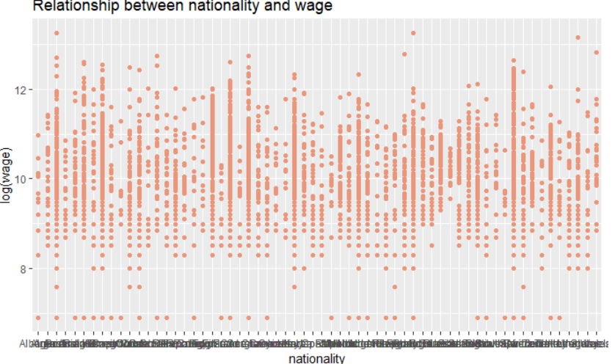
By looking at the relationship of nationality and wage, we can see that players from some countries make more money compared to others.

Slide 12
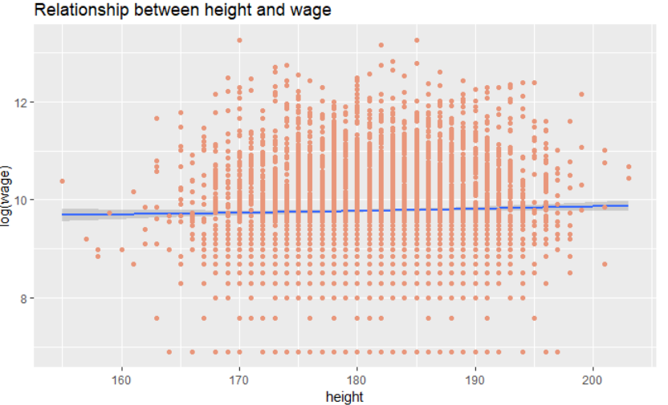
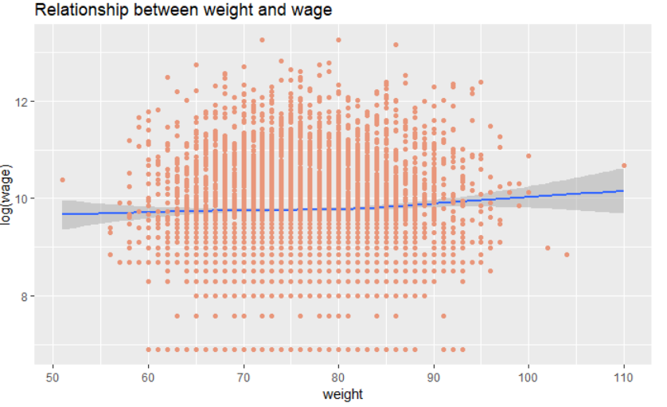
For the relationship between height and wage, I thought that players tend to gain more money if they are taller, but the fact is that height does not have any influence on their wages. By looking at the relationship between weight and wage, what is interesting is that although the influence of players' weight is really tiny, there is still a small tendency that the more weight results in the more wage they get.

Slide 13
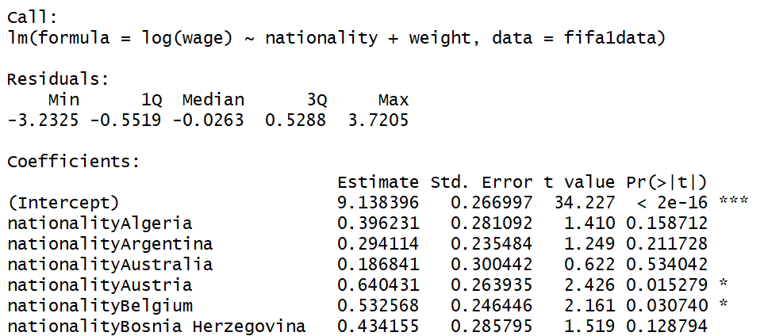
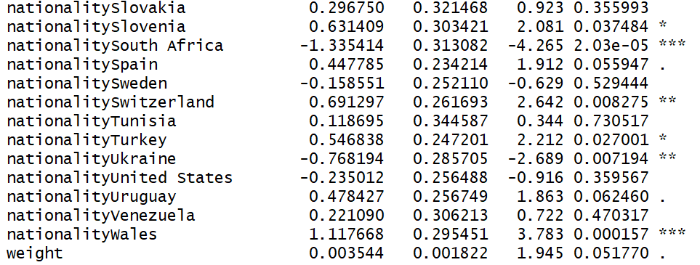
Model Used
Since height seems no impact on wage according to EDA, the linear regression model I used is :
lm(log(wage) ~ nationality + weight)
From the summary, we can clearly find that for a players' weight increases by 1 unit, his wage would increase by 0.003544, which is expected by comparing it with the former EDA. However, compare to weight, nationality has more impact on soccer players' wage.

Slide 14
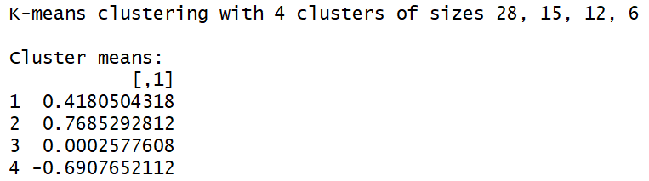
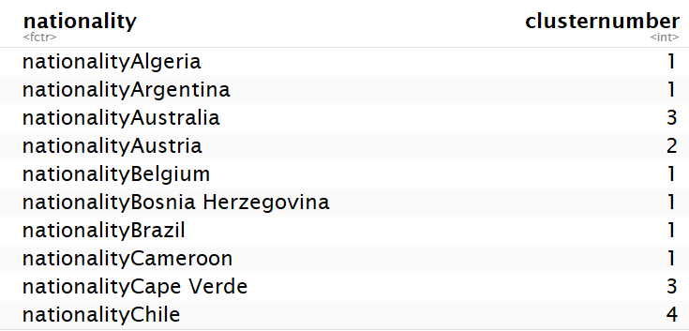
K-means Cluster Method
Since different nationalities would have different impacts on players' wage, in order to have a better interpretation for the impact of nationalities, I am going to use the method K-means clustering to make these nationalities' coefficients into four clusters.

Slide 15
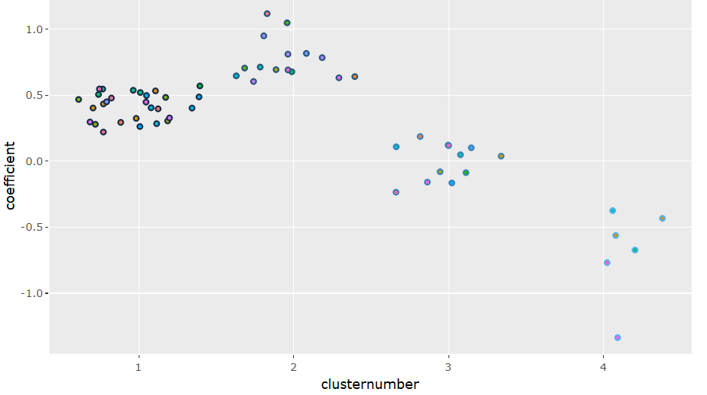
After transferring the data of cluster number into a data frame and a plot, it is easy for us to find that the top soccer players whose nationalities in cluster#2 have more chance to get more wages, such as Germany, Croatia, Egypt, England and so on. Also, the top soccer players whose nationalities in cluster#4 might get relatively fewer wages, such as Chile, Colombia and so on.

Slide 16
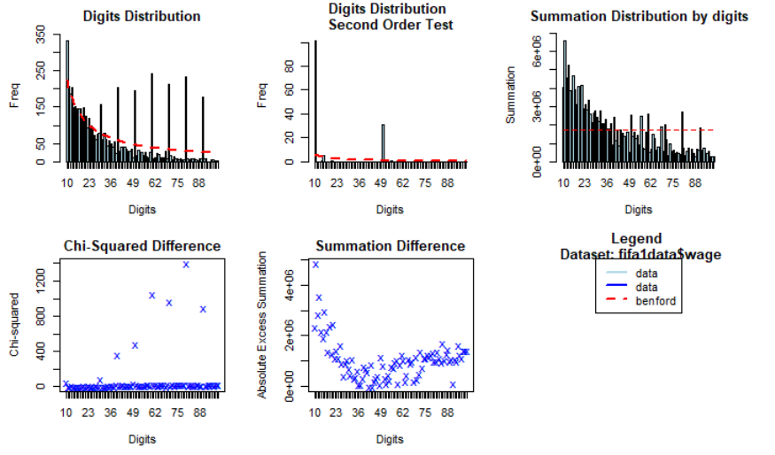
Benford Law Test
Now, one question comes to us. Is this dataset reliable for our analysis?
According to this digit distribution of soccer players' wage, the data somehow have a tendency to follow Benford's law, but discrepancies are also clear at around 30,40,50,60,70 and 80.

Slide 17
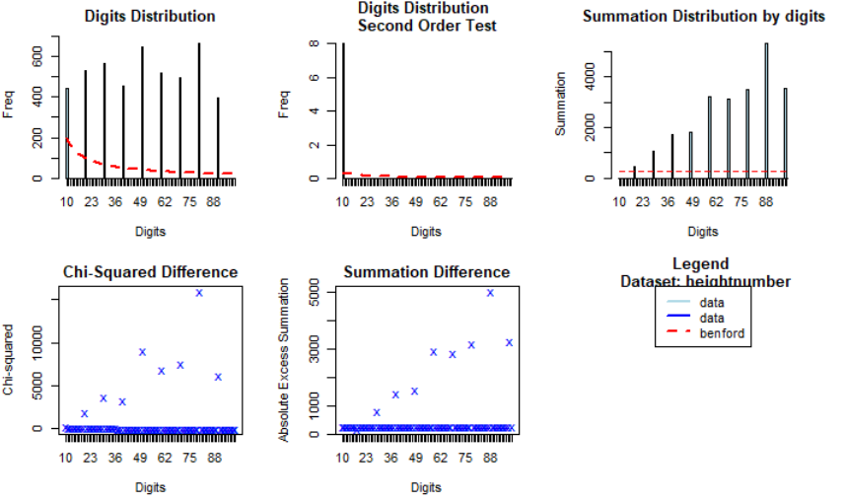
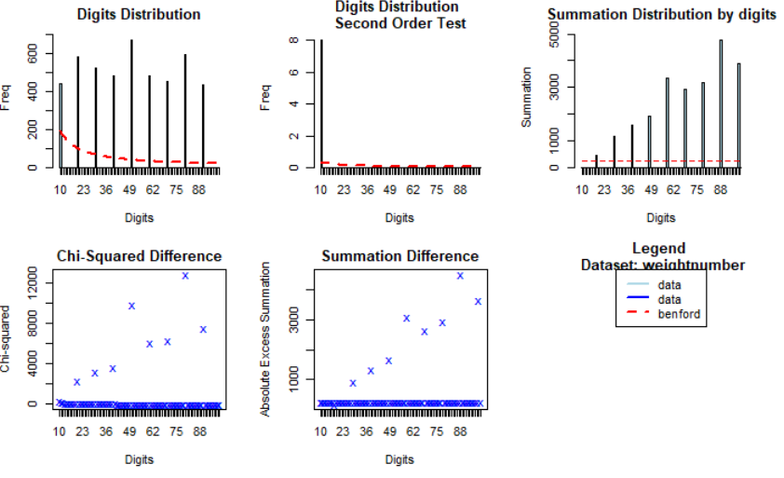
Benford Analysis for Height and Weight
For the Benford Analysis Plot of height (figure1) and weight (figure2), we can clearly find that height and weight does not follow the tendency of Benford’s Law.

Slide 18
Conclusion and Future
In short, a player's height and weight do not have any obvious effect on their wage. Players from some countries would have a higher wage, maybe because their countries pay more attention to the development of sports so that they were better trained and had better physical qualities. Furthermore, the Benford Analysis shows that the data might not authentic enough. In the future, to do a more solid analysis for top soccer players' wage, additional variables and methods are needed.

Slide 19
Thank you and Have a good break!

